Slide 1
Relational Database Definitions
Relational Database Definitions
  Chapter 3
  Carlos Coronel, Steven Morris - Database Systems: Design, Implementation & Management, 13th edition, CENGAGE Learning, 2019, ISBN-13: 978-1337627900.
Database Systems
Robert Dollinger 2021

Slide 2
Relational Database Definitions
  Objective:
  Introduce the basic concepts of the Relational Data Model.
  Main topics:
  - relational schema and relations;
  - integrity constraints;
  - keys and primary keys;
  - foreign keys and referential integrity;
  - enforcing referential integrity.
Database Systems
Robert Dollinger 2021

Slide 3
Relational Database Definitions
Relational database=database organized according to the rules of the relational data model.
Relational data model - the most extensively used data model at this moment.
Advantages:
- surprising simplicity (just a few basic concepts);
- strong mathematical foundations;
- easy to understand;
- provides unprecedented flexibility in design and formulation of queries;
- easy to understand;
- easy to use through query languages like SQL.
Database Systems
Robert Dollinger 2021

Slide 4
Relational Database Definitions
Relational Schema=conceptual model of a relational database, that is the description of the database.
  A Relational Schema consists of one or more relation schemas and, eventually, some integrity constraint(ICs) specifications.
  Each relation schema describes a relation by specifying relation’s name and its attributes.
Relation=set of similar records often depicted as a table. Each record has different values, no duplicate records in a relation.
Note:
Relations are used in the relational data model to represent both entities and relationships.
Database Systems
Robert Dollinger 2021

Slide 5
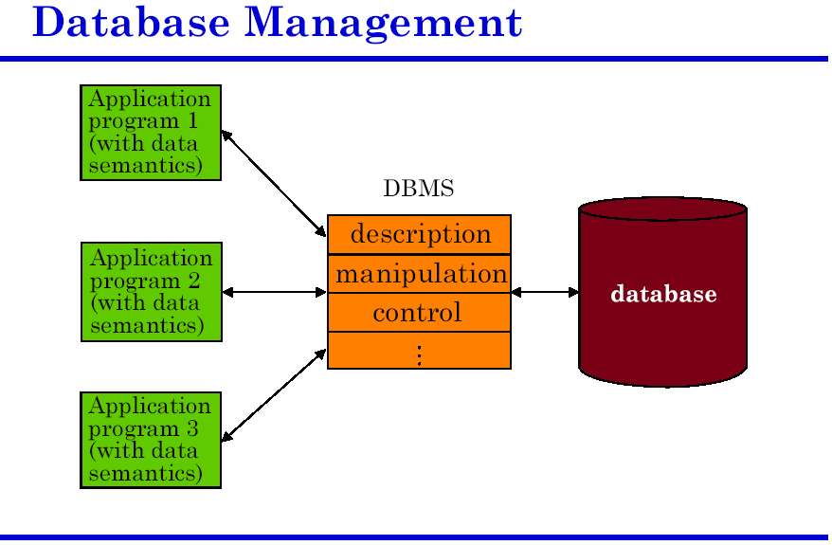
Relational Database Definitions
Relational Schema=Set of Relation Schemas
Data
Views
Database Systems
Robert Dollinger 2021

Slide 6
Relational Database Definitions
Example:
Each of the following describes a relation that will be materialize as a table in the database:
  Supplier(#Supp, Name, City)
  Consumer(#Con, Name, City)
  Product(#Prod, Name, MU)
  Offers(#Supp, #Prod, Quantity, Price)
  Requests(#Con, #Prod, Quantity, Price)
  Transactions(#Tran, #Supp, #Con, #Prod, Quantity, Price)
Each relation description consists of a relation name and a list of attributes.
Key attributes serve as unique identifiers of relation instances and are underlined.
Together the relation descriptions make a relational schema describing the structure of the data in a database.
Database Systems
Robert Dollinger 2021

Slide 7
Relational Database Definitions
Relation
We talk about two aspects of a relation:
Schema=the descriptive part of the relation.
  Specifies name of relation + attributes (name and possibly, type of attribute).
  Schema is the counterpart of class definition in OO programming models.
Instance=materialization of a relation.
  It is a table, with rows (tuples) and columns (attributes).
  Rows = instances of the entity or relationship represented by the relation.
    The number of rows is the cardinality of the relation.
    A row is the counterpart of an object.
  Columns = attributes of the relation.
    The number of columns is the degree or arity of the relation.
Database Systems
Robert Dollinger 2021

Slide 8
Relational Database Definitions
Integrity Constraints (ICs)
Integrity Constraint=condition on data values that must be true for any instance of the database.
Examples
  Price<100;
  Age BETWEEN 16 AND 65;
  SSN is unique;
  Employee should not marry him/her self;
  Parent-child relationships cannot be cyclical;
  There can be no offer without supplier and product;
The integrity constraints ensure that the data is accurate, consistent and complete.
Integrity constraints are a tool to enforce rules on the data automatically through the database management system.
Integrity constraints improve the reliability and quality of the data.
Database Systems
Robert Dollinger 2021

Slide 9
Relational Database Definitions
Types of ICs:
  Semantic ICs – directly originating from the meaning of the data;
    Domain constraints - Can be expressed declaratively and handled automatically by the DBMS;
    Business rules - Can be enforced by developer’s code – see triggers;
  Structural ICs – originating from the data model definition;
    Primary key constraints
    Foreign key constraints
Database Systems
Robert Dollinger 2021

Slide 10
Relational Database Definitions
There are two aspects related to integrity constraints:
Specify
ICs are specified when the database schema is defined and are part of the database description.
Enforce
ICs are automatically checked by the database management system whenever relations are modified, that is when insert, delete or update operations are performed.
A legal instance of a relation is one that satisfies all specified ICs.
Database Systems
Robert Dollinger 2021

Slide 11
Relational Database Definitions
Keys and Primary Key
Key=any minimal subset of attributes that uniquely identifies all tuples of a relation.
Super-key=any subset of attributes that includes a key.
Super-key
Example:
Person(SSN, First_Name, Last_Name, Address, Birthdate, Gender)
First Key Second Key (Candidate Key)
Definition: A set of attributes is a key for a relation if the following 2 conditions are satisfied:
1. No two rows can have the same values in all key fields;
2. Condition 1. is false for any subset of the key.
Database Systems
Robert Dollinger 2021

Slide 12
Relational Database Definitions
  There is always at least one key in a relation be cause, by definition, rows in a relation are unique.
  If there are several keys for a relation, one of the keys is chosen (by the DBA) to be the primary key.
  All other keys will be candidate keys.
Primary Key Constraints
Once a key is defined as primary key of a relation, the DBMS will enforce the following conditions on it:
1) Uniqueness – no two rows will have the same values for the primary key attributes.
2) Not null – all primary key column values must be explicitly specified.
Database Systems
Robert Dollinger 2021

Slide 13
Relational Database Definitions
Foreign Keys, Referential Integrity
  The current relation, called reference relation, contains the foreign key.
  The other relation, where rows are referred, is the referenced relation.
  The matching fields in the referenced relation must be unique identifiers, i.e. they form either a primary key or a candidate key.
  Foreign key = set of fields in one relation that is used to refer to a unique row in another relation.
  Referential integrity rule = all values of the foreign are found in the referenced relation (unless the foreign key is NULL); i.e. a foreign key cannot point to a value/row that does not exist in the referenced relation.
Database Systems
Robert Dollinger 2021

Slide 14
Relational Database Definitions
Example:
Referencing a Primary Key
Employee(SSN, Name, Birthdate, Address, #Dept),
Department(#Dept, Dept_Name, Address, Number_of_Employees).
  #Dept is a foreign key in relation Employee, referencing the primary key #Dept in relation Department;
  Employee is the referenced relation;
  Department is the reference relation;
  The referential integrity constraint requires that all employees belong to a department (unless unassigned to one);
  Cannot have an employee assigned to a department that is not listed in the Department relation.
Database Systems
Robert Dollinger 2021

Slide 15
Relational Database Definitions
Example:
Referencing a Candidate Key
Employee(SSN, Name, Birthdate, Address, Dept_Name),
Department(#Dept, Dept_Name, Address, Number_of_Employees)
where both #Dept and Dept_Name have unique values. #Dept has been declared as primary key and Dept_Name is a candidate key.
  Dept_Name is a foreign key in relation Employee, referencing the candidate key Dept_Name in relation Department;
  The referential integrity constraint requires that all employees belong to a department (unless unassigned to one);
  Cannot have an employee assigned to a department that is not listed in the Department relation.
Database Systems
Robert Dollinger 2021

Slide 16
Relational Database Definitions
Identifying/Non-identifying Referential Integrity Constraint
  Requirement: A foreign key may have either a null value or a value that matches a (primary) key value in a related table.
  The foreign key in the referencing table may or may not have NULL values (e.g. cannot be NULL if part of the primary key).
  Types of referential integrity constraints:
    - identifying – when the foreign key cannot be NULL (like when is part of the primary key in the reference relation);
    - non-identifying – when the foreign key can have NULL values;
Database Systems
Robert Dollinger 2021

Slide 17
Relational Database Definitions
Identifying Referential Integrity Constraint
  When the foreign key is part of the primary key in the referencing table then it can not have null values.
  The foreign key is said to implement an identifying relationship.
  That means the instance of the referencing table can exist only if it references a unique instance in the referenced table of which it is dependent of.
  Example:
  Supplier(Supp_ID, Name, City),
  Product(Prod_ID, Name),
  Offers(Supp_ID,Prod_ID,Quantity,Price)
    The Supp_ID and Prod_ID columns are both part of the primary key in the Offers table.
    Offers has an identifying relationship both with Supplier and Product, which means that one can not have an offer unless there is a supplier and a product.
    Furthermore, both the supplier and the product are uniquely identified by the offer.
Database Systems
Robert Dollinger 2021

Slide 18
Relational Database Definitions
Non-identifying Referential Integrity Constraint
  If the foreign key is not part of the primary key in the referencing table and it is defined to accept nulls, then it implements a non-identifying relationship.
  In the case of a non-identifying relationship one can have instances of the referencing table that do not point to any instance of the referenced table (foreign key is null).
Database Systems
Robert Dollinger 2021

Slide 19
Relational Database Definitions
  Example:
  Employee(SSN, Name, Birthdate, Address, #Dept),
  Department(#Dept, Dept_Name, Address, Employee_Count)
    The #Dept column in Employee is a foreign key referencing the Department relation, but it is not part of the primary key.
    Two situations are possible:
      - the #Dept column in the Employee table does not accept null values (defined with NOT NULL) in which case the Employee_Department relationship is an identifying one; this means all employees have to be assigned to a department;
      - the #Dept column in the Employee table accepts null values (defined with NULL) in which case the Employee_Department relationship is a non-identifying one; this means the Employee table may contain employees that are not assigned to any department.
Database Systems
Robert Dollinger 2021

Slide 20
Relational Database Definitions
Enforcing Referential Integrity
  Referential integrity may only be affected when one of the DML operations (INSERT, DELETE, UPDATE) is performed on the database.
  DBMS provide the means for enforcing referential integrity of the data it stores.
  Referential integrity may be enforced:
    - declaratively – as a database constraint, standard feature supported by the DBMS;
    - procedurally – by using triggers, with code provided by the developer.
Database Systems
Robert Dollinger 2021

Slide 21
Relational Database Definitions
Enforcement Strategies
Every DBMS implements two basic strategies for referential integrity enforcement:
- restrict DML operations – reject the INSERT, DELETE or UPDATE operation if it violates referential integrity;
- cascade DML operations – allow the INSERT, DELETE or UPDATE operation and perform corrective operations to preserve referential integrity of the data.
Database Systems
Robert Dollinger 2021

Slide 22
Relational Database Definitions
Examples: Enforcing Referential Integrity – Identifying Case
Consider the relations:
Employee(SSN, Name, Birthdate, Address, #Dept),
Department(#Dept, Dept_Name, Address, Employee_Count)
where #Dept cannot have NULL values.
1. What should be done if an Employee tuple with a nonexistent #Dept is inserted?
Reject the INSERT operation!
2. What should be done if a Department row is deleted?
Typically, one of the following alternatives can be applied:
1) Also delete all Employee rows that refer to it, that is all employees in that department.
2) Disallow deletion of a Department row that is referred to by at least one Employee row, that is, as long as there are employees hired in that department.
Database Systems
Robert Dollinger 2021

Slide 23
Relational Database Definitions
Identifying Referential Integrity Enforcement Map
Strategy | Reference Table (Foreign Key) |  |  | Referenced Table (Primary Key)
 | INSERT | DELETE | UPDATE | INSERT | DELETE | UPDATE
Restrict | Can’t do if reference is missing | OK, anytime | Can’t do if reference is missing | OK, anytime | Can’t do if referenced | Can’t do if referenced
Cascade | Can’t do if reference is missing | OK, anytime | Can’t do if reference is missing | OK, anytime | Delete referencing tuples as well (propagate) | Update referencing tuples as well (propagate)
Database Systems
Robert Dollinger 2021

Slide 24
Relational Database Definitions
Examples: Enforcing Referential Integrity – Non-Identifying Case
Consider the relations:
Employee(SSN, Name, Birthdate, Address, #Dept),
Department(#Dept, Dept_Name, Address, Employee_Count)
where #Dept can have NULL values.
1. What should be done if an Employee tuple with a nonexistent #Dept is inserted?
Set #Dept to NULL.
2. What should be done if a Department row is deleted?
Typically, one of the following alternatives can be applied:
1) Also delete all Employee rows that refer to it, that is all employees in that department.
2) Delete the Department row and set #Dept to NULL in all dependent rows from the Employee table; that is, for all employees previously hired in that department.
Database Systems
Robert Dollinger 2021

Slide 25
Relational Database Definitions
Non-Identifying Referential Integrity Enforcement Map
Strategy | Reference Table (Foreign Key) |  |  | Referenced Table (Primary Key)
 | INSERT | DELETE | UPDATE | INSERT | DELETE | UPDATE
Restrict | Can’t do if reference is missing, unless NULL | OK, anytime | Can’t do if reference is missing, unless NULL | OK, anytime | Can’t do if referenced | Can’t do if referenced
Cascade | Can’t do if reference is missing, unless NULL | OK, anytime | Can’t do if reference is missing, unless NULL | OK, anytime | Set to NULL referencing foreign keys | Set to NULL referencing foreign keys
Database Systems
Robert Dollinger 2021

Slide 26
Relational Database Definitions
Expressing Integrity Constraints in Relational Databases
Integrity constraints can be expressed:
1. Declaratively – through specific syntax; there are four types of integrity constraint declarations most DBMS support:
PRIMARY KEY – primary key constraint;
FOREIGN KEY – referential integrity constraint;
UNIQUE – unique values in the column;
CHECK – domain constraints as expressions relating column value within the same row.
2. Procedurally – through custom code placed in triggers for anything that cannot be expressed declaratively.
Database Systems
Robert Dollinger 2021

Slide 27
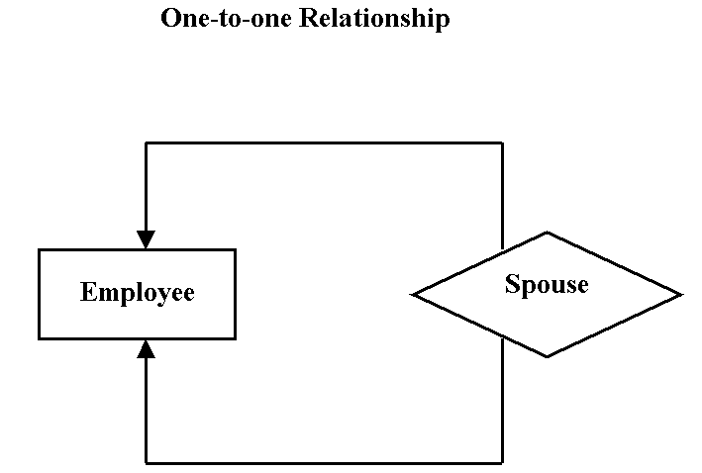
Relational Database Definitions
Example:
Consider the self-referencing Employee entity and the Spouse relationship in the diagram below:
Database Systems
Robert Dollinger 2021

Slide 28
Relational Database Definitions
Relational Representation
The self-referencing Employee entity type, and the 1 to 1 relationship named Spouse in the diagram will be represented in a relational database by one single table as follows:
Employee(Employee_Id, Spouse_Id, … (other column))
Where:
Employee_Id – is the primary key in table Employee;
Spouse_Id – is a foreign key in table Employee referencing table Employee.
Database Systems
Robert Dollinger 2021

Slide 29
Relational Database Definitions
Enforcing Integrity Constraints
1. How can we enforce the rule that an Employee is not his/her own spouse?
Answer:
This constraint can be enforced by making sure that the employee and her spouse are different persons, identified by different ID values.
A CHECK constraint expressing that relationship can be declared as follows:
CHECK Employee_Id <>Spouse_Id
2. How can we enforce a rule that prevents same sex marriage?
Answer:
This constraints requires expressing a relationship between two different rows of the table and it cannot be enforced declaratively.
The solution is to add a new column called Gender to the Employee table and write a trigger where the code makes sure that Gender in current row is different from Gender in referenced row.
Database Systems
Robert Dollinger 2021

Slide 30
?
?
?
?
?
?
?
?
?
?
?
?
?
?
Database Systems
Robert Dollinger 2021

